Slide 1
General Debiasing for Graph-based Collaborative Filtering via Adversarial Graph Dropout
https://github.com/Arthurma71/AdvDrop.
（WWW-2024)
Reported by Ke Gan

Slide 2
1. Introduction
2. Approach
3. Experiments

Slide 3
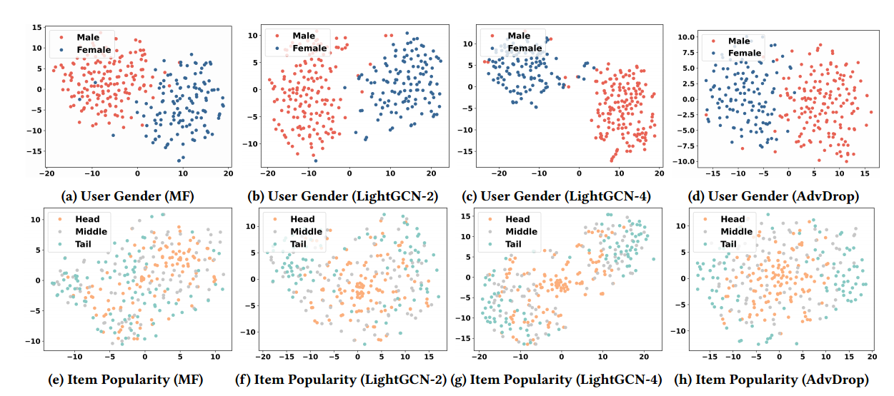
Introduction
a user’s interactions with items can be driven by both unbiased true interest and various biased factors like item popularity or exposure
current aggregation approach combines both biased and unbiased, learning distorted views of users/items

Slide 4
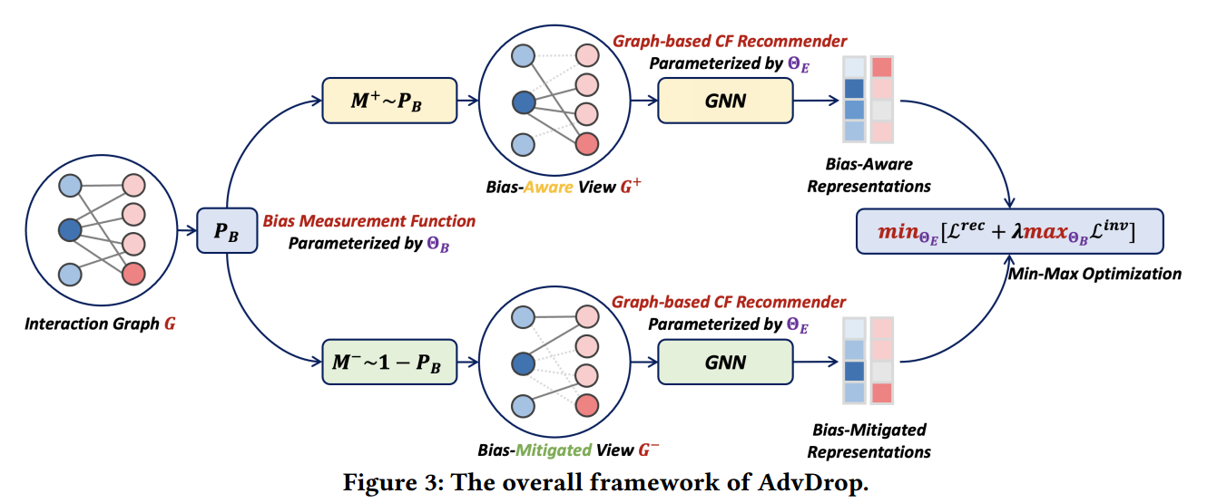
Approach

Slide 5
Approach

Slide 6
Approach

Slide 7
Approach

Slide 8
Experiment

Slide 9
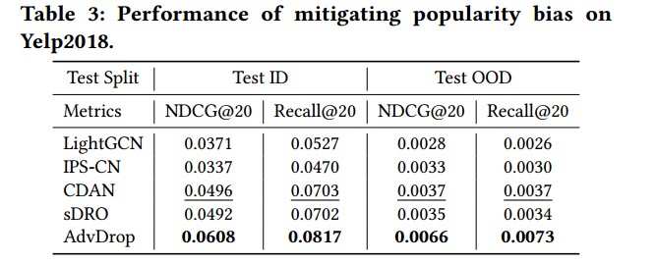
Experiment

Slide 10
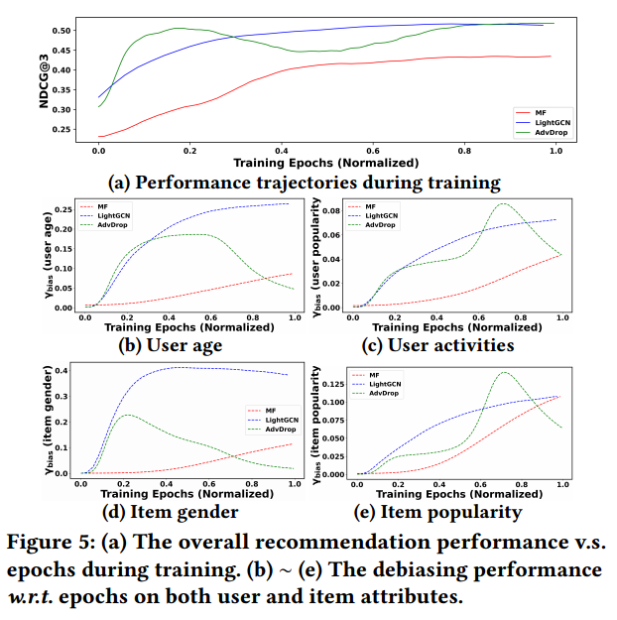
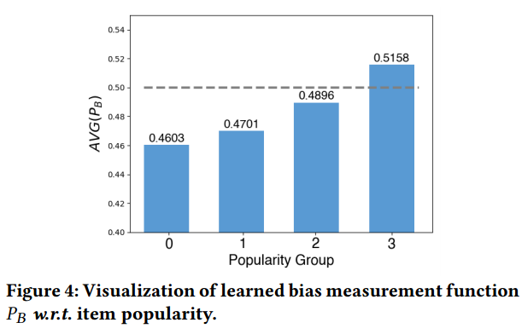
Experiment

Slide 11
Thank you!

